Slide 1
An Overview of Array Signal Processing
Mirza Asif Haider and Saidur Rahman Pavel
Advanced
Signal
Processing
Laboratory

Slide 2
Outline
Introduction
Array system applications
Array configurations
Array signal model
Beamforming
Phased array
Zero forcing
MVDR
DOA estimation
Preliminaries
DOA estimation using beamforming
Sub-space-based DOA estimation
Discuss about a paper
Possible Research Direction
Slide and sample code: https://github.com/saidurpavel/IEEE_seminar_cuet

Slide 3
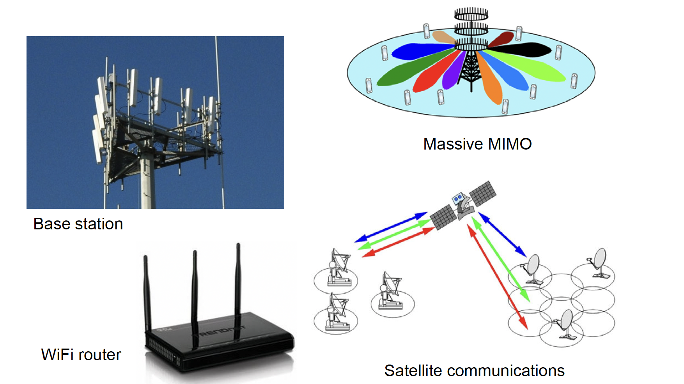
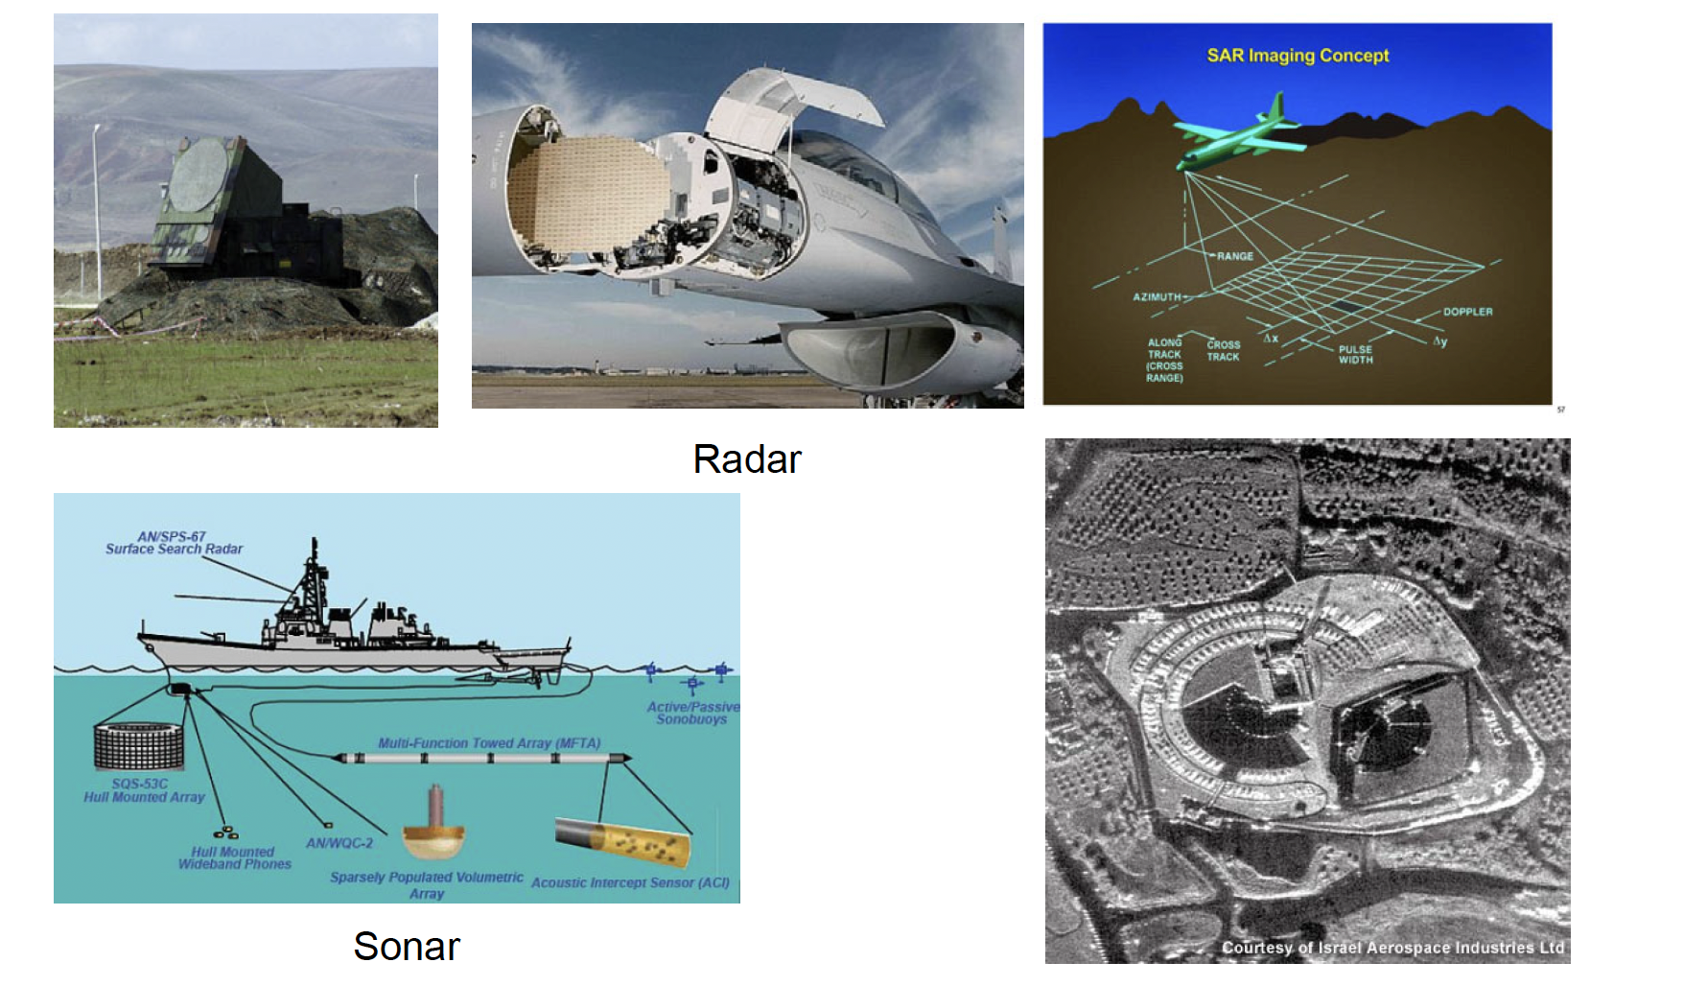
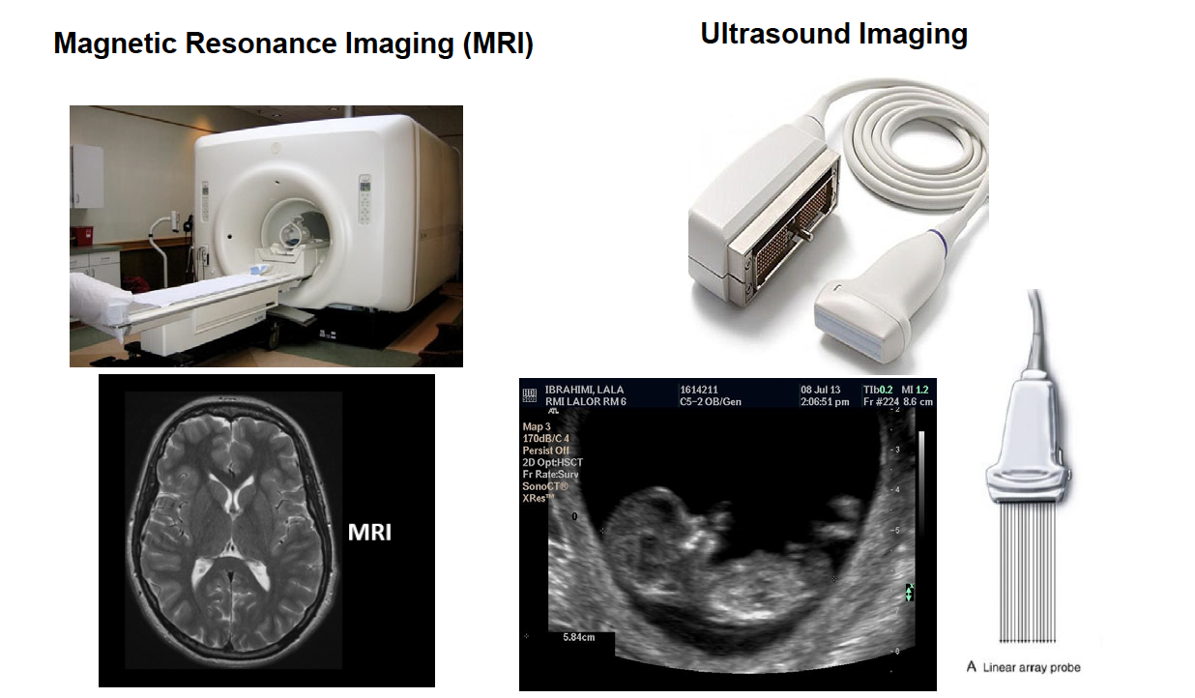
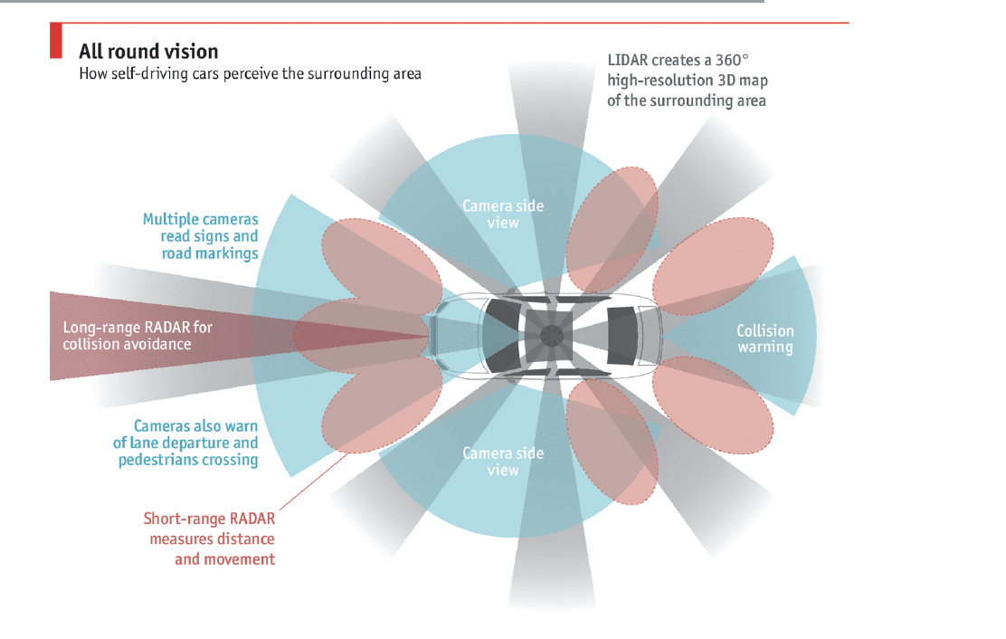
Array systems
Communication
Radar and Sonar
Medical Applications
Autonomous driving

Slide 4
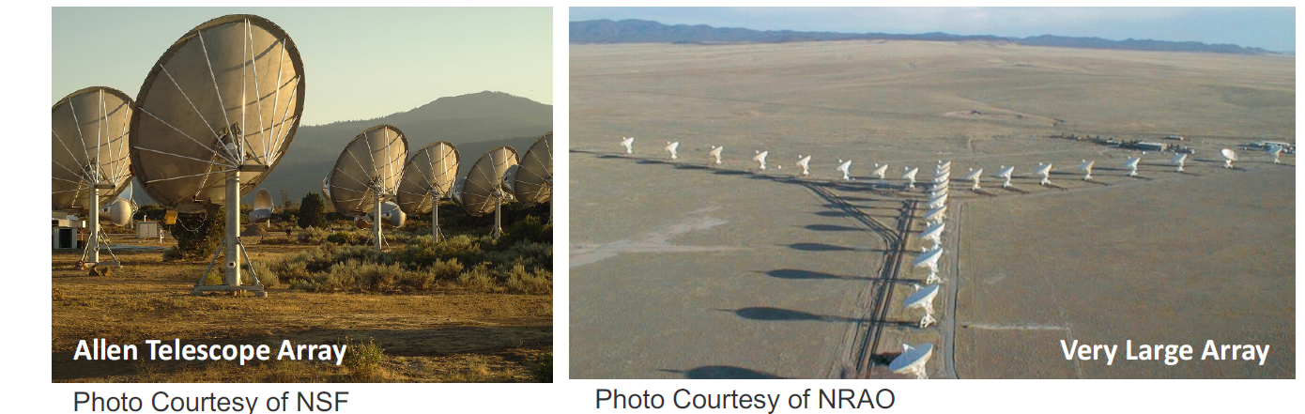
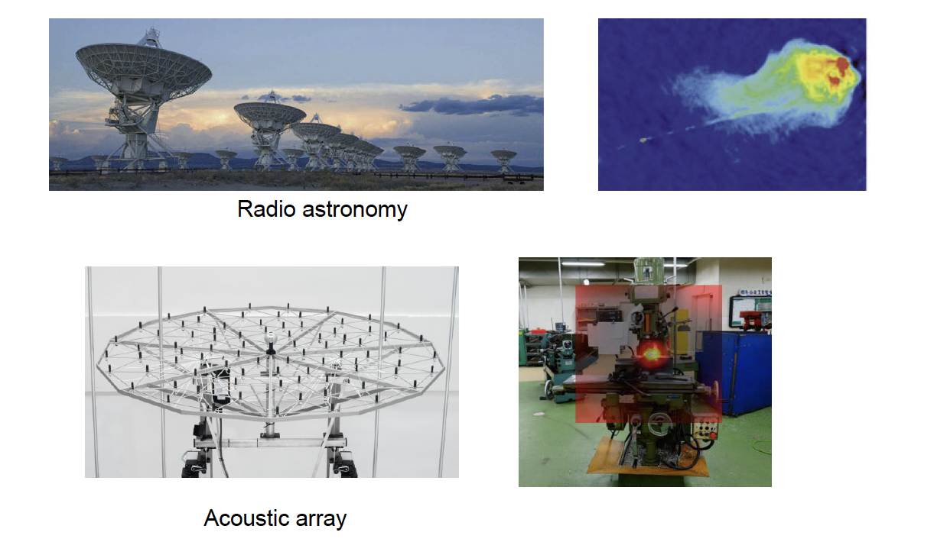
Other Applications

Slide 5
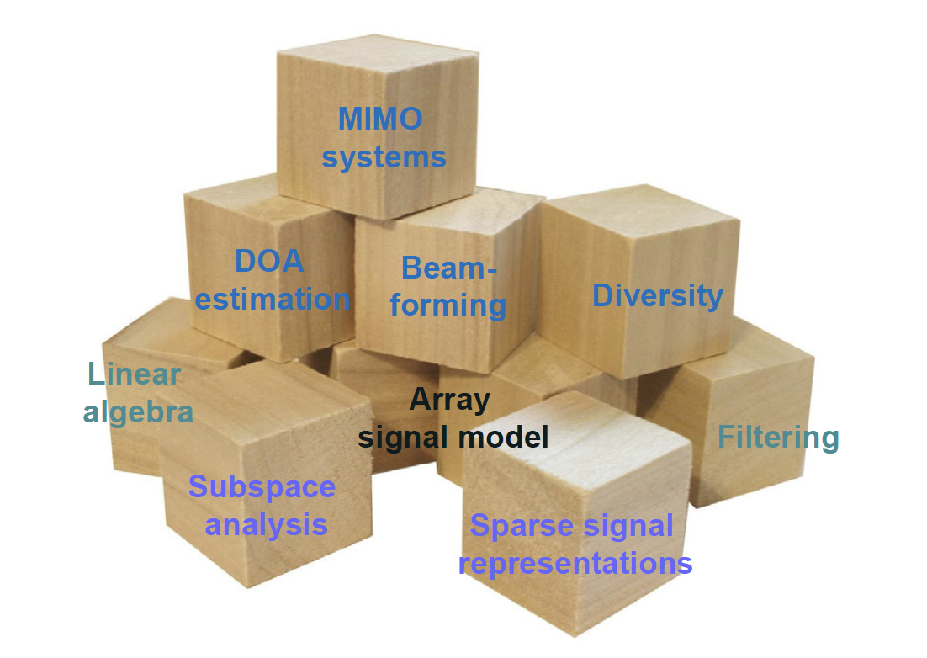
Array Signal Processing

Slide 6
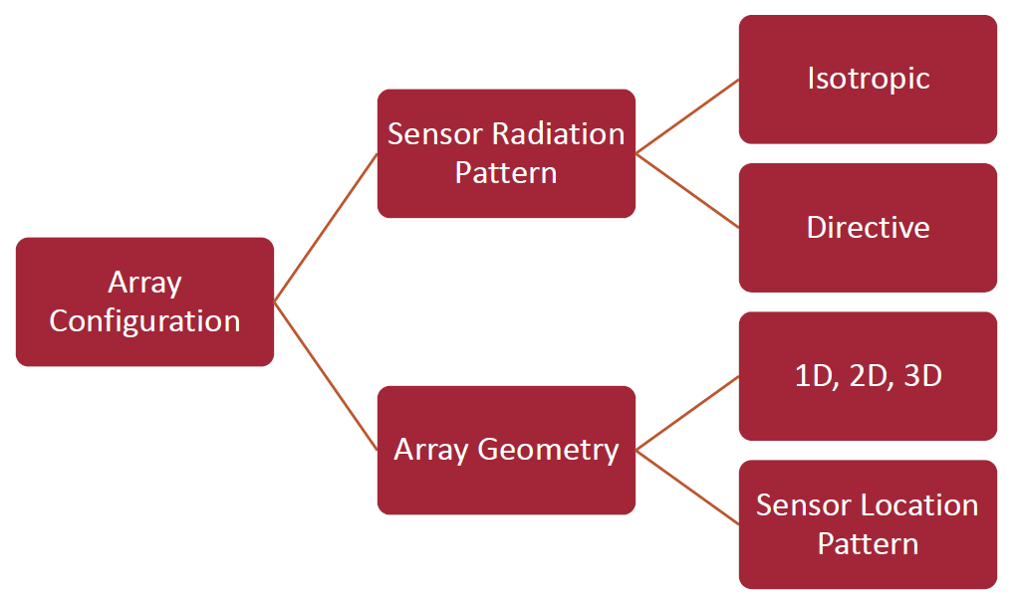
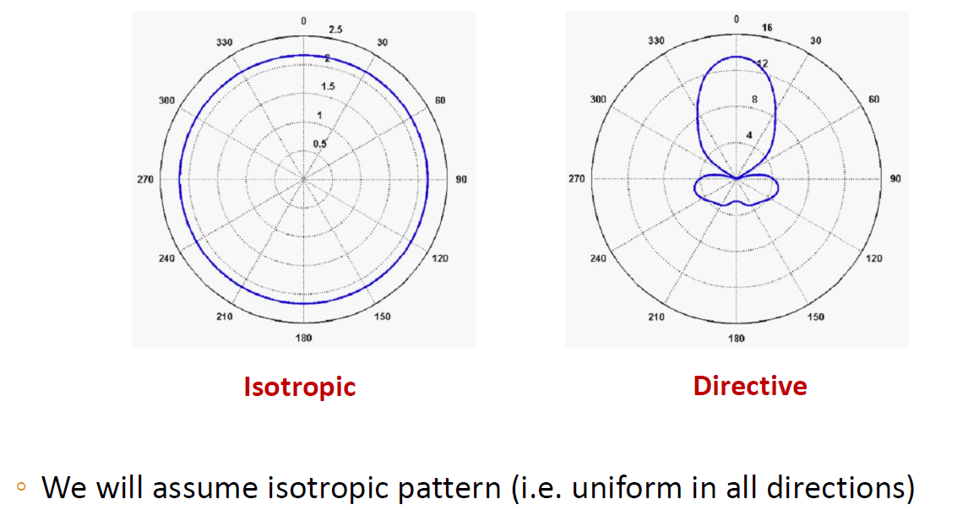
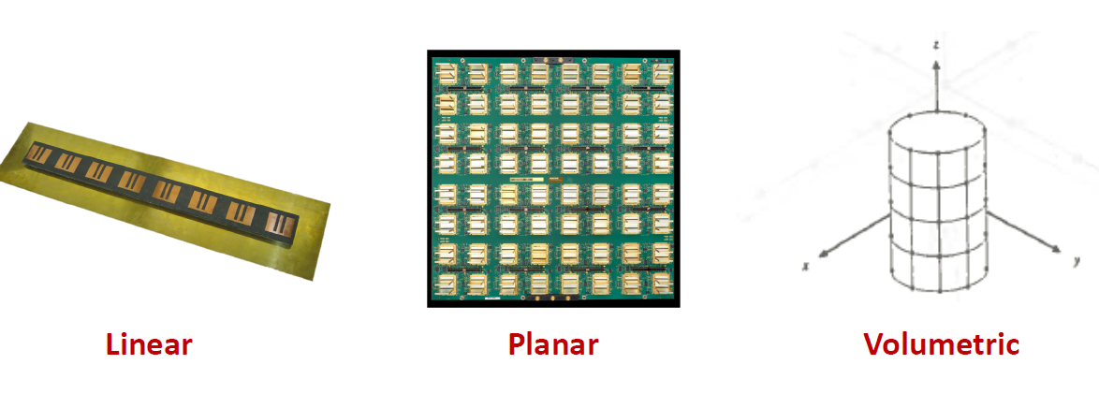
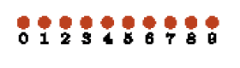
Array Configuration
Radiation pattern
Uniform array:
Non uniform/
sparse array
Sensor Locations
Array Geometry

Slide 7
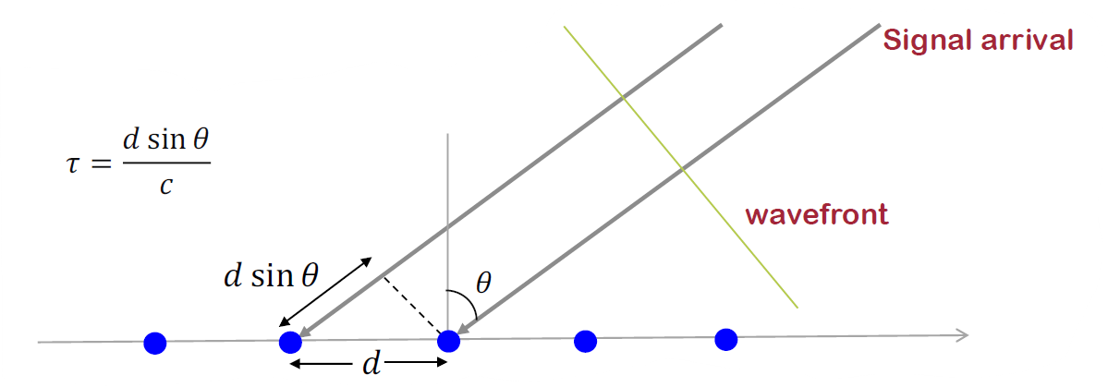
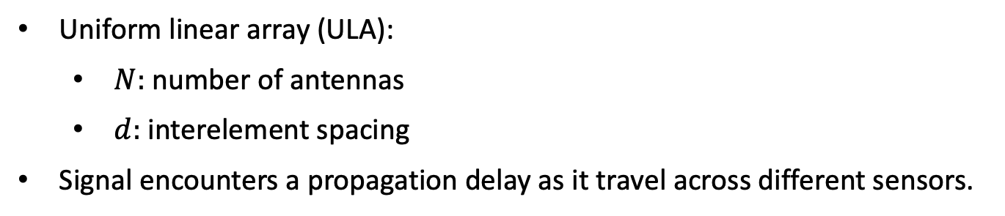
Array Signal Model
Uniform linear array (ULA):
$N:$ number of antennas
$d:$ interelement spacing
Signal encounters a propagation delay as it travel across different sensors.

Slide 8
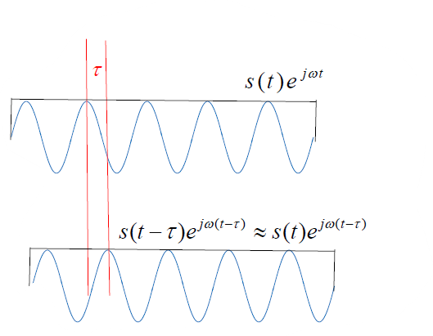
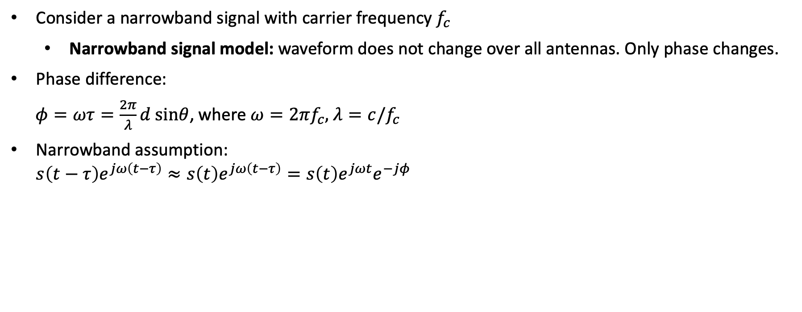
Array Signal Model
Consider a narrowband signal with carrier frequency $f_{c}$
Narrowband signal model: waveform does not change over all antennas. Only phase changes.
Phase difference:
$φ=ωτ=\frac{2π}{λ}d sinθ$, where $ω=2πf_{c},$ $λ=c/f_{c}$
Narrowband assumption: $s\left(t−τ\right)e^{jω\left(t−τ\right)}≈s\left(t\right)e^{jω\left(t−τ\right)}=s\left(t\right)e^{jωt}e^{−jφ}$
Narrowband
assumption

Slide 9
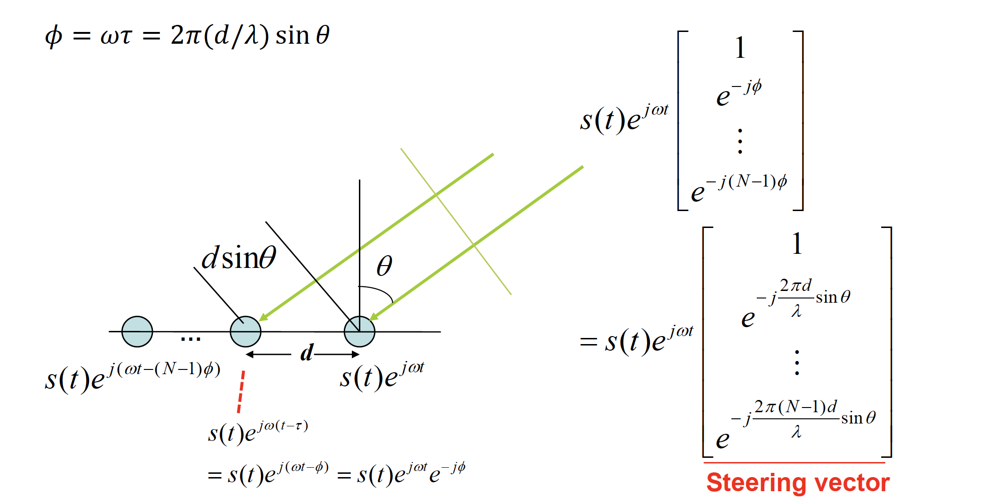
Array Signal Model: Steering vector
Received signal vector for a uniform linear array (ULA):

Slide 10
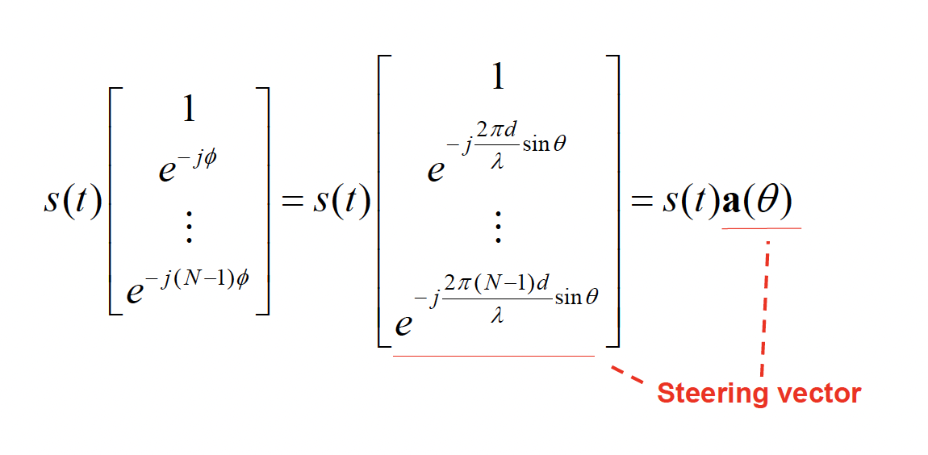
Array Signal Model: Baseband Model
Usually, the array signal is processed at baseband (the carrier component is removed).
Baseband received signal vector for a uniform linear array (ULA):

Slide 11
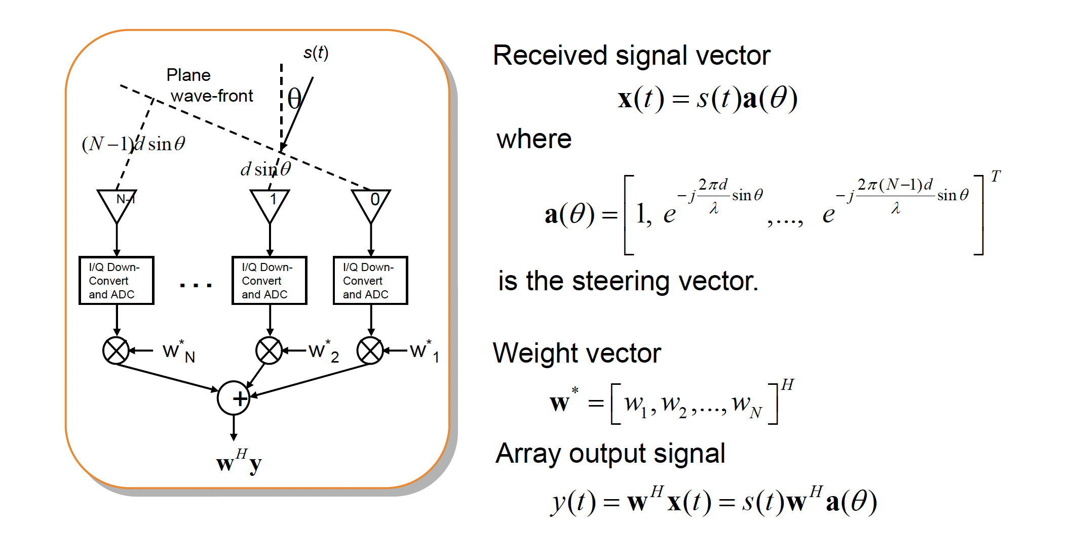
Beamforming
Beamforming or spatial filtering is a signal processing technique used in sensor arrays for directional signal transmission or reception.
This is achieved by combining elements in an antenna array in such a way that signals at particular angles experience constructive interference while others experience destructive interference.

Slide 12
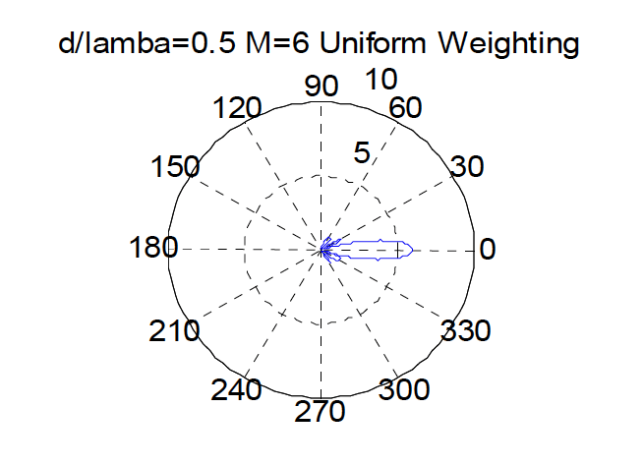
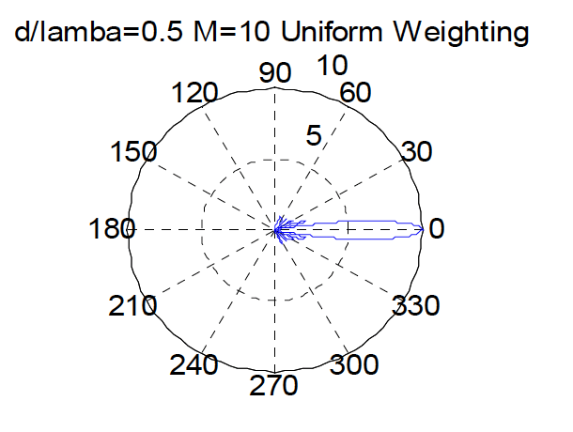
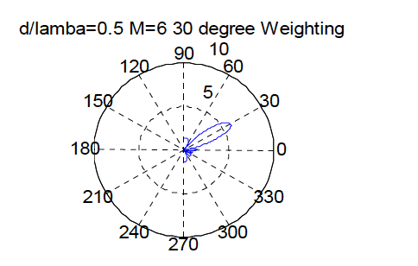
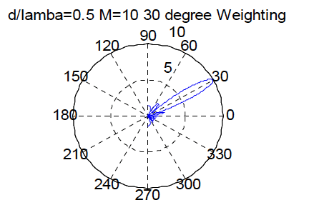
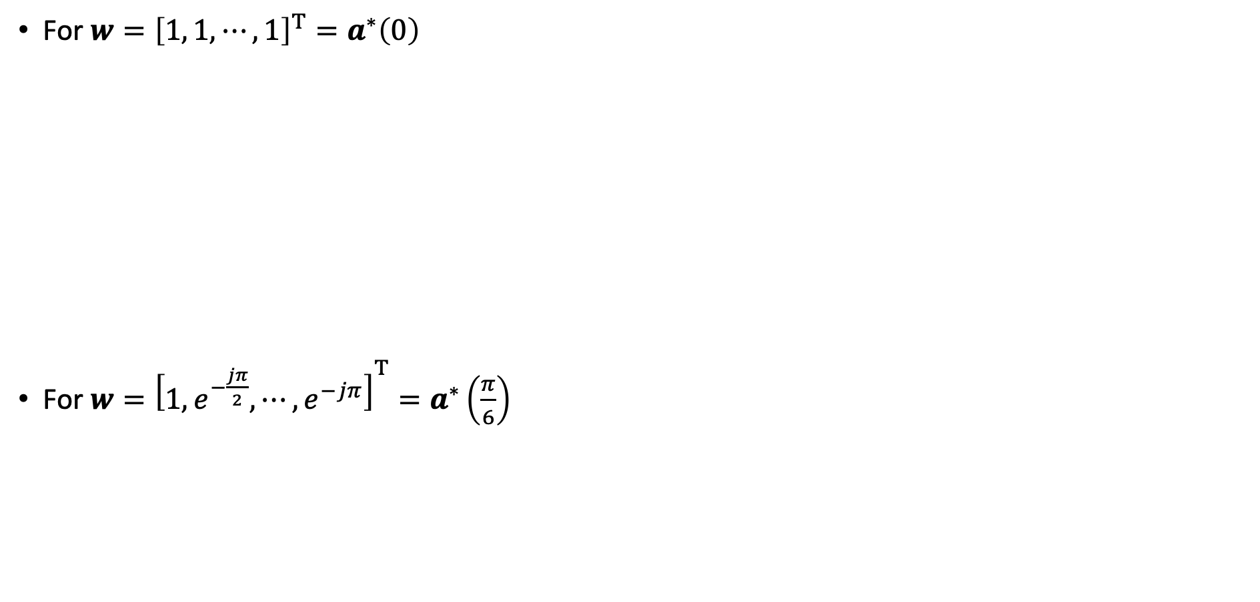
Beamforming
For $w={\left[1, 1, ⋯,1\right]}^{T}=a^{∗}\left(0\right)$
For $w={\left[1, e^{−\frac{jπ}{2}}, ⋯,e^{−jπ}\right]}^{T}=a^{∗}\left(\frac{π}{6}\right)$
The beam resolution increase with the increase of the antenna
Number of antennas = 6
Number of antennas = 10

Slide 13
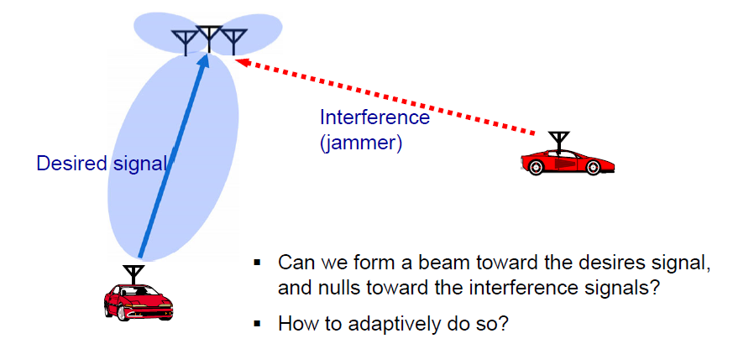
Beamforming

Slide 14
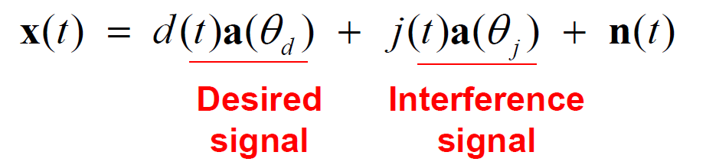
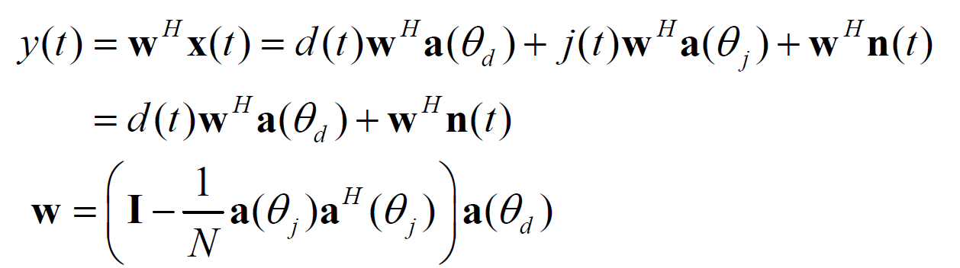
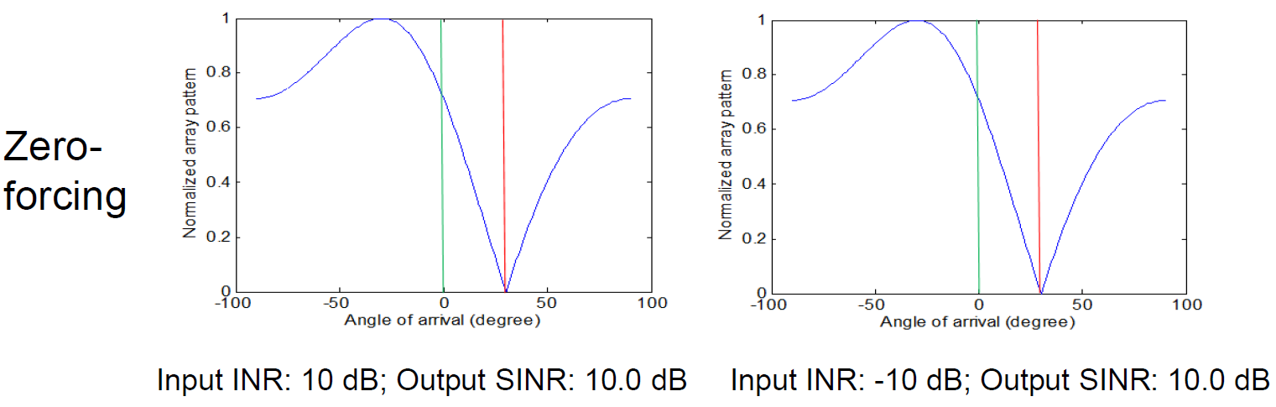
Zero Forcing Algorithm
Consider received signal vector
If we chose the weight vector w such that $w^{H}a\left(θ_{j}\right)=0$, the array output signal becomes
Interference is completely suppressed ➔ Zero-forcing algorithm:

Slide 15
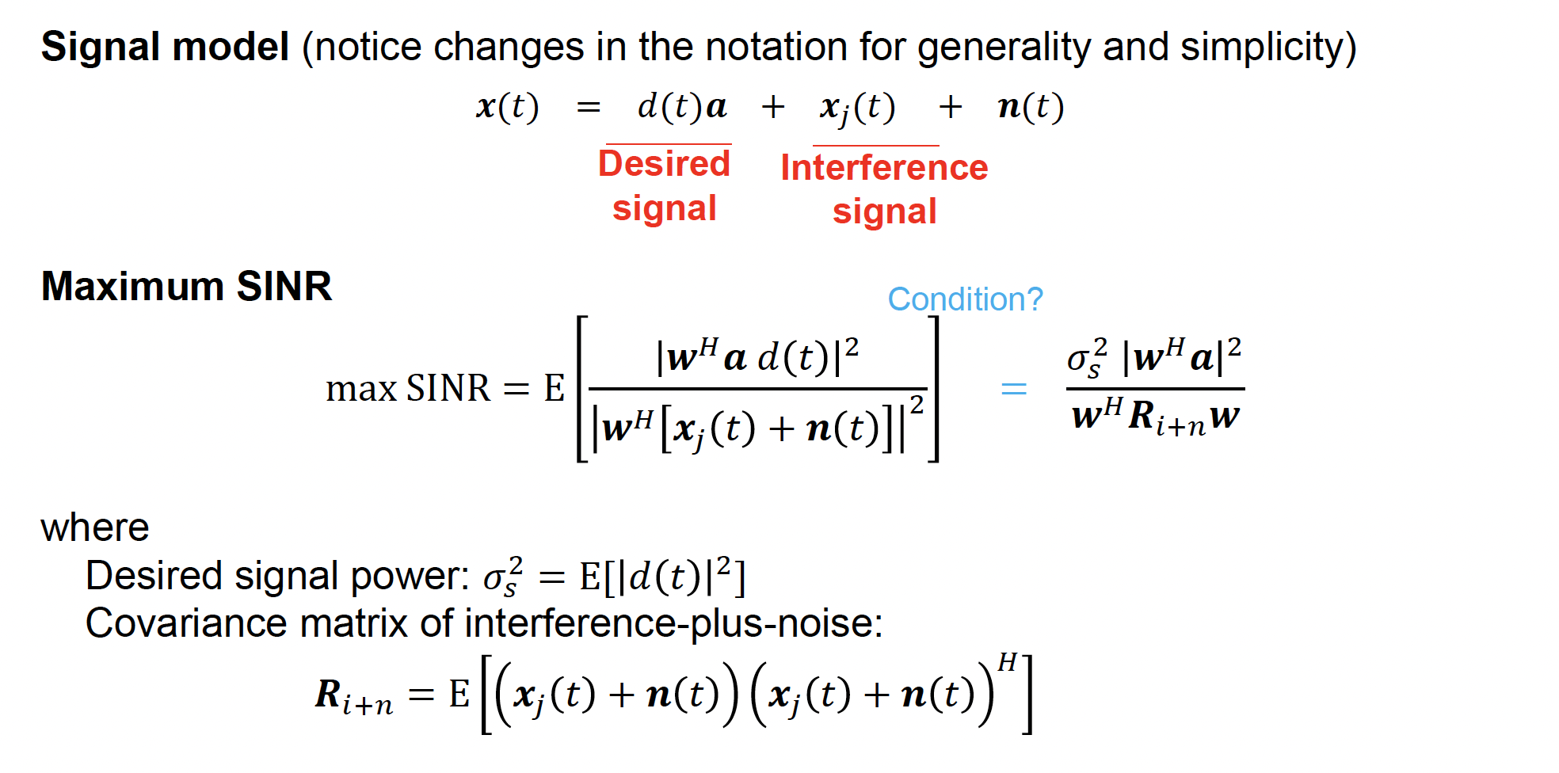
MVDR beamforming

Slide 16
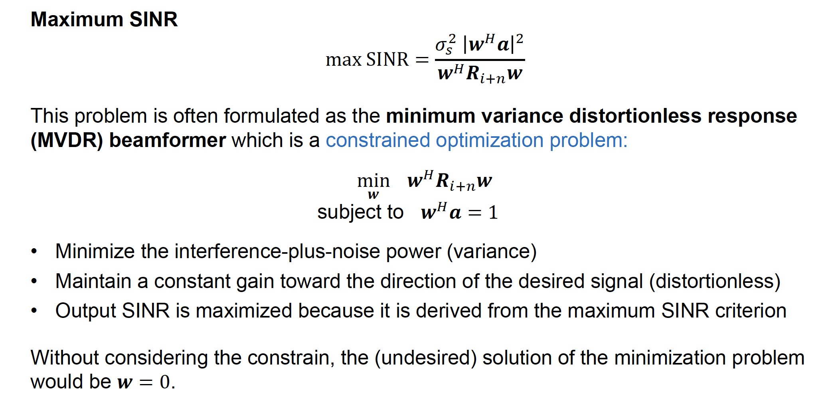
MVDR beamforming

Slide 17
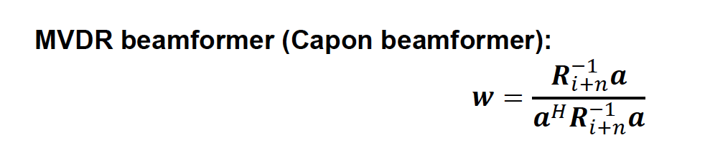
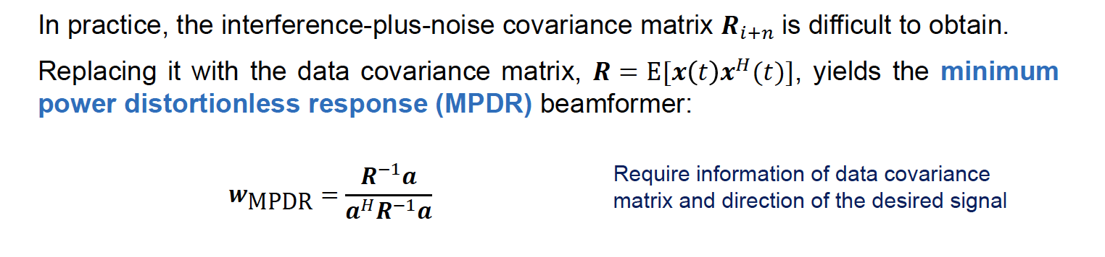
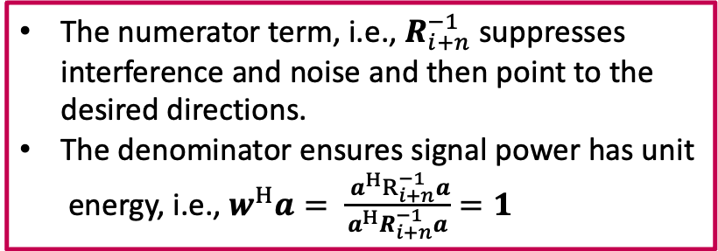
MVDR beamforming
The numerator term, i.e., $R_{i+n}^{−1}$ suppresses interference and noise and then point to the desired directions.
The denominator ensures signal power has unit energy, i.e., $w^{H}a= \frac{{ a^{H}R}_{i+n}^{−1}a}{a^{H}R_{i+n}^{−1}a}=1$

Slide 18
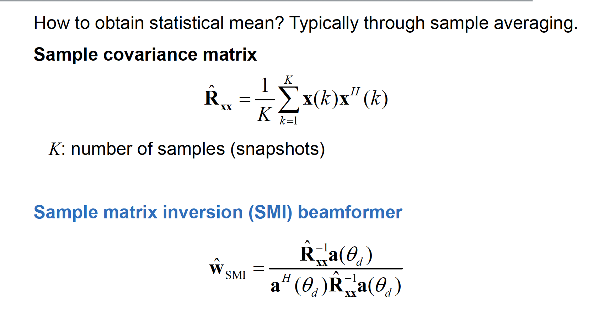
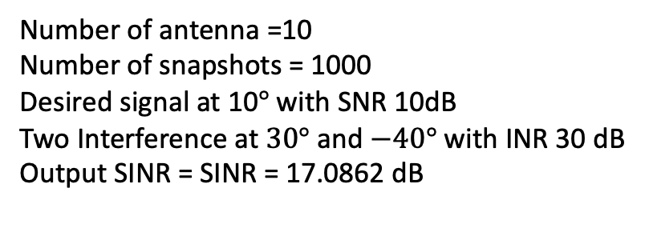
Sample Matrix Inversion
Number of antenna =10
Number of snapshots = 1000
Desired signal at 10$°$ with SNR 10dB
Two Interference at $30°$and $−40°$ with INR 30 dB
Output SINR = SINR = 17.0862 dB

Slide 19
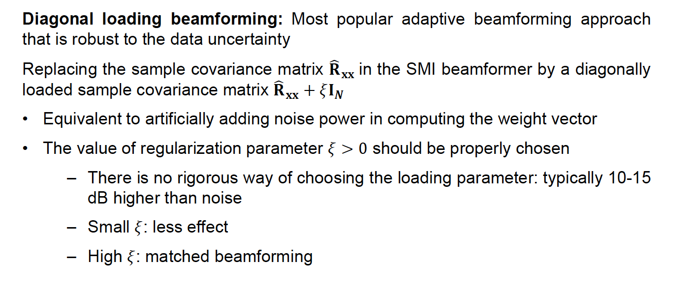
Robust beamforming: Diagonal loading

Slide 20
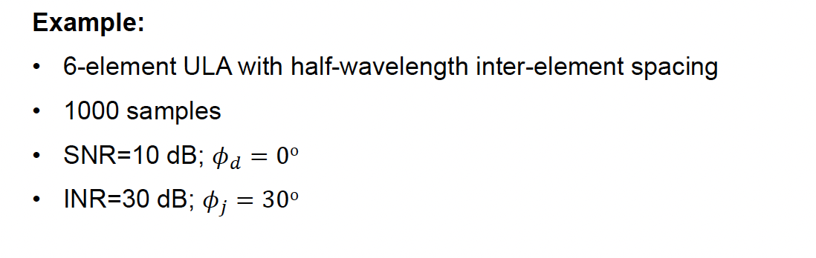
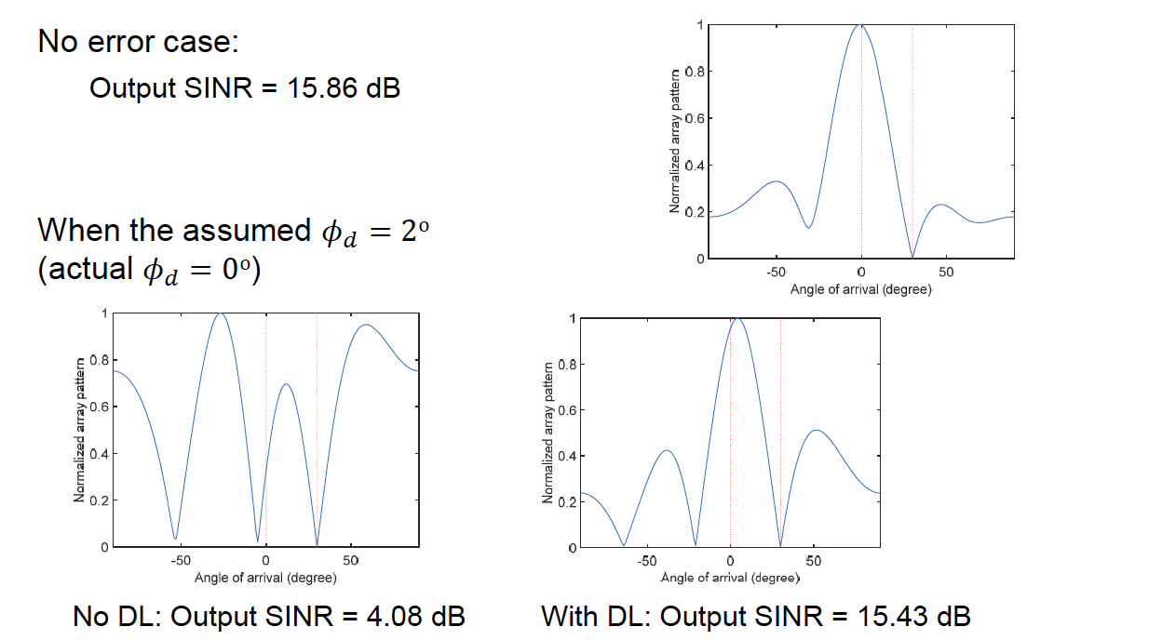
Robust beamforming: Diagonal loading

Slide 21
Additional Beamforming Algorithms
Worst-Case Beamformer:
Optimizes array weights assuming the worst-case mismatch between the actual and presumed signal steering vector.
Interference Plus Noise Covariance matrix Reconstruction:
To use MVDR, interference-plus-noise compressed covariance matrix can be reconstruced by solving optimization problem.

Slide 22
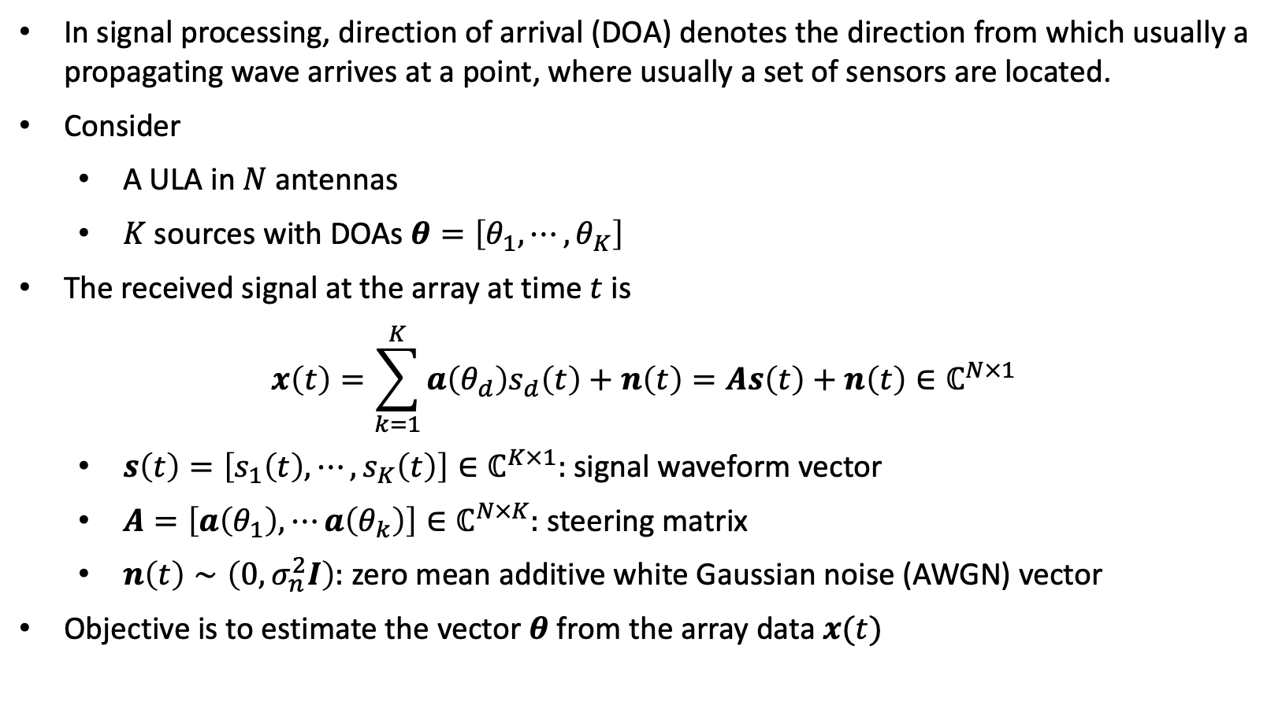
Direction of Arrival (DOA) estimation
In signal processing, direction of arrival (DOA) denotes the direction from which usually a propagating wave arrives at a point, where usually a set of sensors are located.
Consider
A ULA in $N$ antennas
$K$ sources with DOAs $θ=\left[θ_{1}, ⋯,θ_{K}\right]$
The received signal at the array at time $t$ is
$$x\left(t\right)=\sum_{k=1}^{K}{a\left(θ_{d}\right)s_{d}\left(t\right)+n\left(t\right)=As\left(t\right)+n\left(t\right)∈ℂ^{N×1}}$$
$s\left(t\right)=\left[s_{1}\left(t\right), ⋯,s_{K}\left(t\right)\right]∈ℂ^{K×1}:$ signal waveform vector
$A=\left[a\left(θ_{1}\right), ⋯a\left(θ_{k}\right)\right]∈ℂ^{N×K}:$ steering matrix
$n\left(t\right)∼\left(0,σ_{n}^{2}I\right):$ zero mean additive white Gaussian noise (AWGN) vector
Objective is to estimate the vector $θ$ from the array data $x(t)$

Slide 23
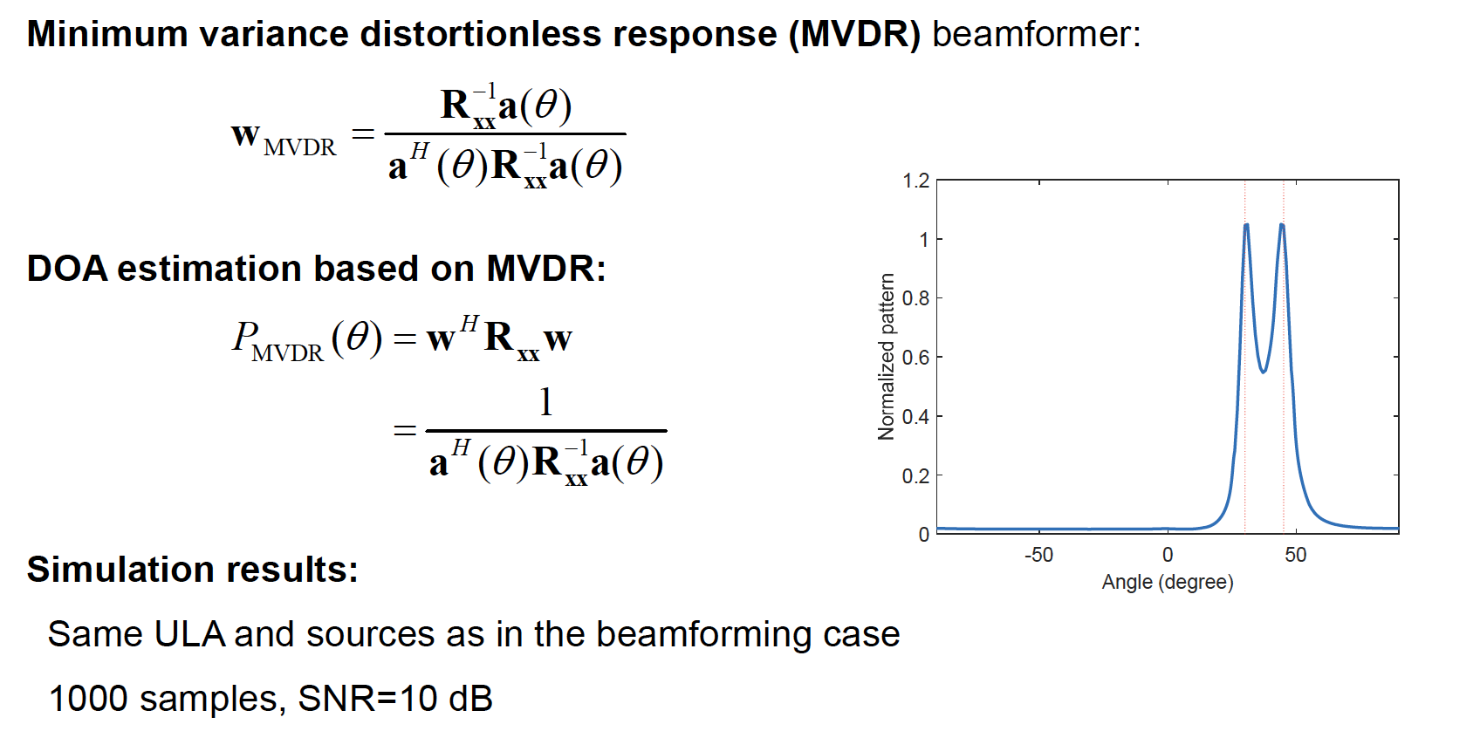
DOA Estimation Using Beamforming
No of antennas = 10
Number of signals = 7
SNR = 10dB, Snapshots T = 100
$$P=𝔼\left[{\left|y\left(t\right)\right|}^{2}\right]=𝔼\left[{\left|w^{H}x\left(t\right)\right|}^{2}\right]={𝔼[\left(\left|w^{H}x\left(t\right)\right|\right)}^{H}\left(\left|w^{H}x\left(t\right)\right|\right)]=w^{H}𝔼\left[x\left(t\right)x^{H}\left(t\right)\right]w=w^{H}R_{xx}w$$

Slide 24
Matrix Rank
Rank of a Matrix: The rank of a matrix is defined as
(a) the maximum number of linearly independent column vectors in the matrix; or
(b) the maximum number of linearly independent row vectors in the matrix.
Rank of a matrix defined the dimension of the subspace spanned by the linearly independent column.

Slide 25
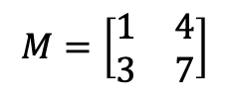
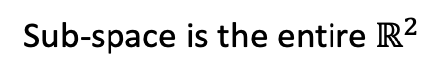
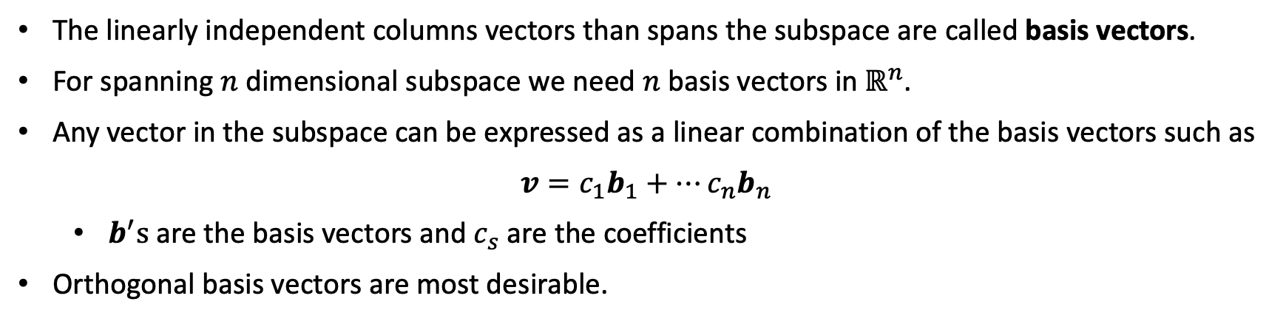
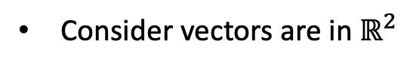
Matrix Rank
Consider vectors are in $ℝ^{2}$
$$M=\left[\begin{matrix}1 & 4 \\ 3 & 7\end{matrix}\right]$$
$$M=\left[\begin{matrix}1 & 2 \\ 3 & 6\end{matrix}\right]$$
Sub-space is the entire $ℝ^{2}$
Sub-space confined in a line
The linearly independent columns vectors than spans the subspace are called basis vectors.
For spanning $n$ dimensional subspace we need $n$ basis vectors in $ℝ^{n}$.
Any vector in the subspace can be expressed as a linear combination of the basis vectors such as
$$v=c_{1}b_{1}+⋯c_{n}b_{n}$$
$b^{′}s$ are the basis vectors and $c_{s}$ are the coefficients
Orthogonal basis vectors are most desirable.

Slide 26
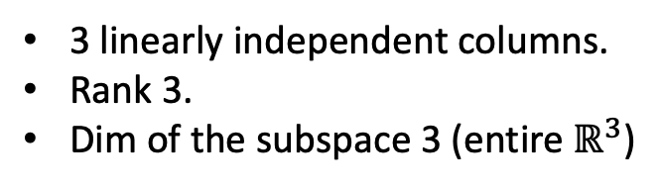
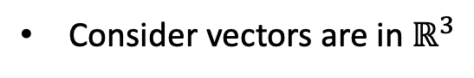

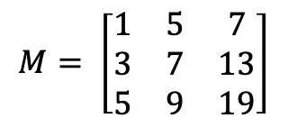
Matrix Rank
Consider vectors are in $ℝ^{3}$
$$M= \left[\begin{matrix}1 & 5 & 0 \\ 3 & 7 & 13 \\ 0 & 0 & 10\end{matrix}\right]$$
$$M= \left[\begin{matrix}1 & 5 & 7 \\ 3 & 7 & 13 \\ 5 & 9 & 19\end{matrix}\right]$$
Col3 = 2*col1+col2
3 linearly independent columns.
Rank 3.
Dim of the subspace 3 (entire $ℝ^{3}$)
2 linearly independent columns.
Rank 2.
Dim of the subspace 2 (Plane)

Slide 27
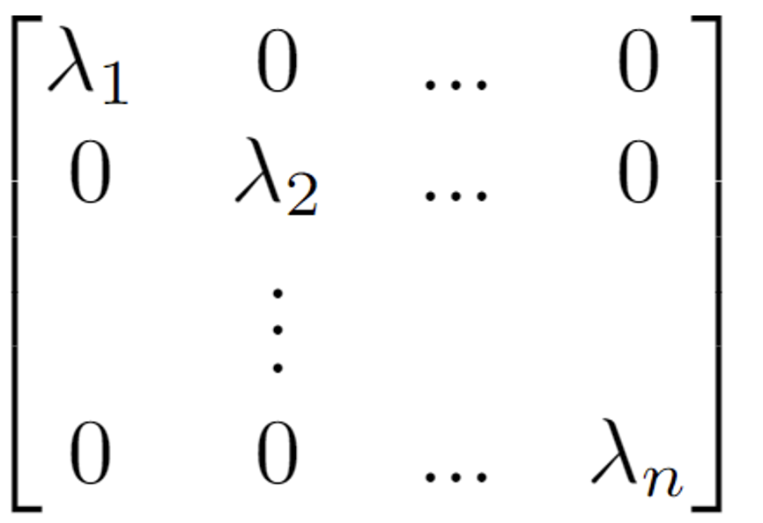
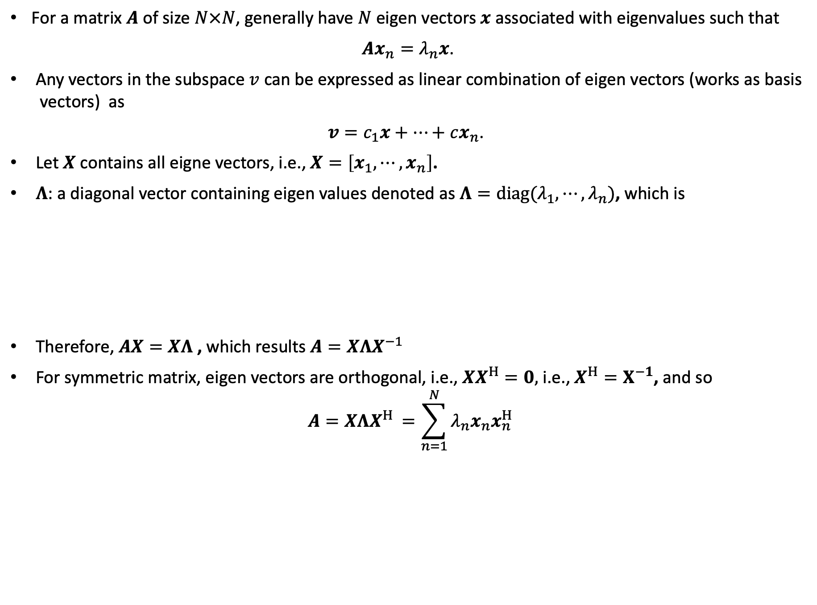
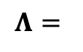
Eigen decomposition
For a matrix $A$ of size $N×N$, generally have $N$ eigen vectors $x$ associated with eigenvalues such that
$$Ax_{n}=λ_{n}x\text{. }$$
Any vectors in the subspace $v$ can be expressed as linear combination of eigen vectors (works as basis vectors) as
$$v=c_{1}x+⋯+cx_{n}\text{. }$$
Let $X$ contains all eigne vectors, i.e., $X=\left[x_{1}, ⋯,x_{n}\right]$.
$Λ$: a diagonal vector containing eigen values denoted as $Λ=diag(λ_{1}, ⋯, λ_{n})$, which is
Therefore, $AX=XΛ$, which results $A=XΛX^{−1}$
For symmetric matrix, eigen vectors are orthogonal, i.e., $XX^{H}=0,$ i.e., $X^{H}=X^{−1}$, and so
$$A=XΛX^{H }=\sum_{n=1}^{N}{λ_{n}x_{n}x_{n}^{H}}$$
$$Λ=$$
Spectral theorem in linear algebra

Slide 28
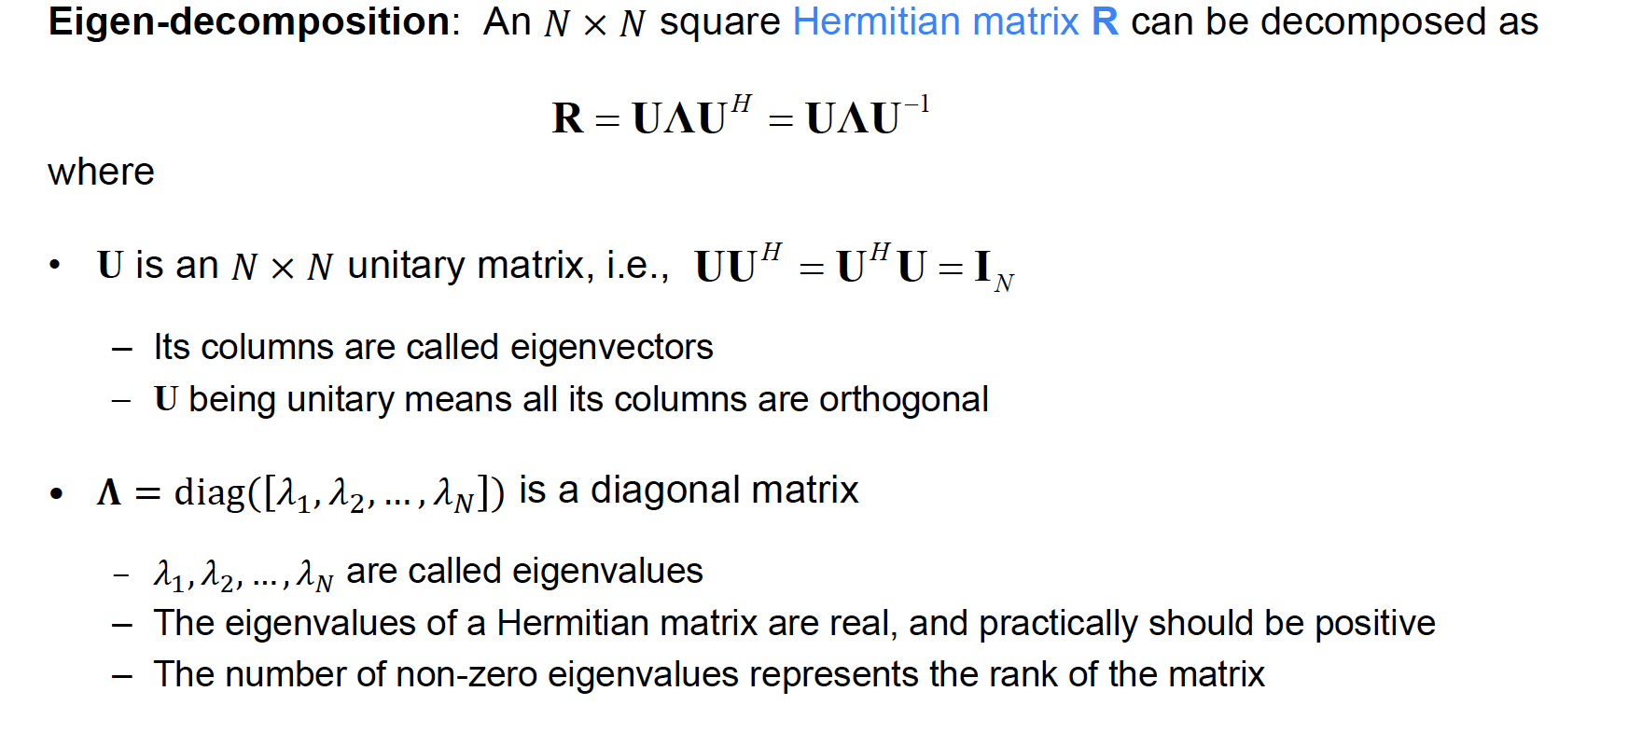
Eigen Decomposition

Slide 29

Signal Subspace Analysis

Slide 30

Signal Subspace Analysis

Slide 31

DOA estimation: MUSIC (Multiple Signal Classification)

Slide 32

DOA estimation: MUSIC (Multiple Signal Classification)

Slide 33


DOA estimation: MUSIC (Multiple Signal Classification)
The steering vectors$,a\left(θ\right)$i.e., the columns of $A(θ)$are elements of a set (not a subspace), termed the array manifold.
It composed of all possible steering vectors obtained as 8 ranges over the entire parameter space.
The desired steering vectors (which contains the DOA) are the intersection of the signal subspace and the array manifold.
Equivalently, finding elements of the array manifold that is orthogonal to the noise subspace will provide desired steering vectors, hence the DOAs.
Three sensor, two source example

Slide 34



DOA estimation: MUSIC (Multiple Signal Classification)
$$U_{n}=\left[v_{N+1}, …,v_{N}\right]$$
$$U_{n}^{H}a\left(θ\right)= \left[\begin{matrix}v_{M+1}^{H}a\left(θ\right) \\ ⋮ \\ v_{N}^{H}a\left(θ\right)\end{matrix}\right]$$
$${\left|\left|U_{n}^{H}a\left(θ\right)\right|\right|}^{2}=\sum_{m=M+1}^{N}{|}v_{m}^{H}a\left(θ\right){\left.​\right|}^{2}$$
$${\left|\left|U_{n}^{H}a\left(θ\right)\right|\right|}^{2}={\left(U_{n}^{H}a\left(θ\right)\right)}^{H}\left(U_{n}^{H}a\left(θ\right)\right)$$

Slide 35
DOA estimation: MUSIC (Multiple Signal Classification)
No of antennas = 10
Number of signals = 7
SNR = 10dB, Snapshots T = 100
What is the maximum number of signals can be detected using a ULA with 10 antenna elements?

Slide 36




Off-Grid Direction-of-Arrival Estimation Using Coprime Array Interpolation
$M:$ Number of sensors in the sparse ULA 1
$N:$ Number of sensors in sparse ULA 2
$Nd:$Interelement spacing for sparse ULA 1
$Md:$ Interelement spacing for sparse ULA 2
$d=λ/2$, $λ:$ wavelength of the signal
$M,N$ are coprime integers
Total number of sensors = $M+N−1$
Sparse ULA 1
Sparse ULA 2
The sensor locations in the array
Coprime array
C. Zhou, Y. Gu, Z. Shi, and Y. D. Zhang, “Off-grid direction-of-arrival estimation using coprime array interpolation,” vol. 25, no. 11, pp. 1710–1714, 2018.

Slide 37




Off-Grid Direction-of-Arrival Estimation Using Coprime Array Interpolation
For example, $M=5, N=3$
$k:$ time index, $J:$ Number of signals
$x_{𝕊}\left(k\right)∈ℂ^{\left|𝕊\right|×J}:$ Array signal received to the coprime array
$y_{𝕌}\left(k\right):$ Array signal corresponds to virtual ULA, Initialized as
Binary mask
Objective is to recover the data/covariance matrix entries corresponding to the missing sensors.
0
1
2
3
4
5
6
7
8
9
10
11
12
Coprime array
Virtual ULA
$$b=[1,0,0,1,0,1,1,0,0,1,1,0,1]$$

Slide 38



Off-Grid Direction-of-Arrival Estimation Using Coprime Array Interpolation
Covariance matrix for the Augmented ULA is
The correlations in the rows and columns corresponding to the missing sensors are zeros
The non-zero elements are the correlations of the actual signals $x_{𝕊}\left(k\right)$received in the coprime array.
The full covariance matrix can be recovered by solving the following optimization problem
Once the full covariance matrix is obtained, DOA can be estimated using any method like MUSIC

Slide 39


Possible Research Direction
DOA estimation
Communication
Radar

Slide 40


Possible Research Direction
Beamforming
Communication
Hybrid beamforming

Slide 41

Possible Research Direction
ISAC (integrated sensing and communication) system

Slide 42

Possible Research Direction
Machine learning based DOA estimation

Slide 43

References
Don H. Johnson and Dan E. Dudgeon, Array Signal Processing: Concepts and Techniques. Prentice Hall, 1993.
Harry L. Van Trees, Optimum Array Processing: Part IV of Detection, Estimation, and Modulation Theory. Wiley, 2002.
H. Karim and M. Viberg, “Two decades of array signal processing research,” IEEE Signal Processing Magazine, July 1996.
A. Paulraj, B. Ottersten, R. Roy, A. Swindlehurst, G. Xu, and T. Kialath, “Subspace Methods for Directions-of-Arrival Estimation,” in N. K. Bose and C. R. Rao (eds.), Handbook of Statistics, 1993.

